Slide 1
Development Guide HD New FW

Slide 2
Contents
Create new module
Import module into project (eclipse)
Build and run
Appendices
Service
Author: phuongkim – Date: 14/03/2016

Slide 3
Development guide HD New FW
Create new module
Author: phuongkim – Date: 14/03/2016

Slide 4
>>Create new module Contents
Define package and class
Pom xml file
Module class
View provider class
Panel provider class
Model class
Author: phuongkim – Date: 14/03/2016

Slide 5
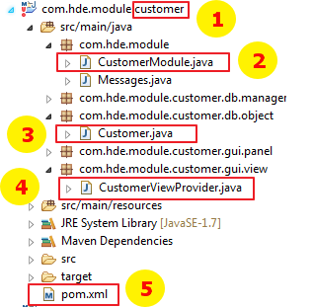
>> Create new module Define package and class
All packages and classes are defined like image
Module name (replace all “customer” to your module name)
Module class
Model class
View provider class
Pom xml file
Author: phuongkim – Date: 14/03/2016

Slide 6
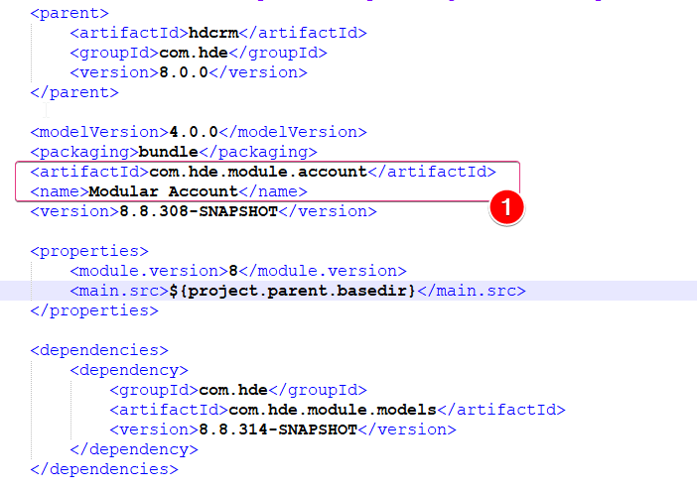
>> Create new module Pom xml file
Point to your module and define its name
Author: phuongkim – Date: 10/06/2019

Slide 7
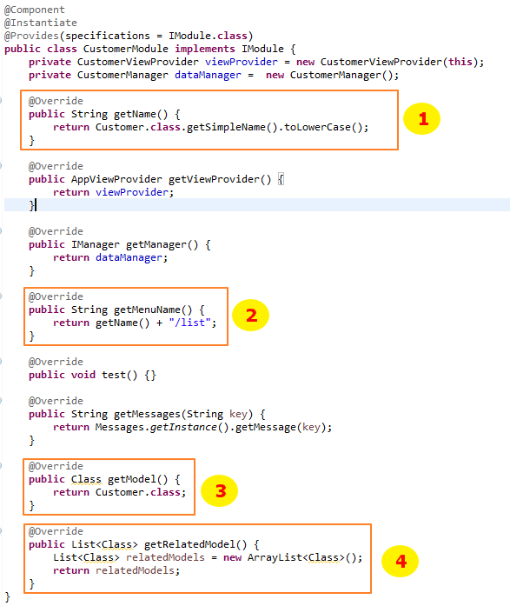
>> Create new module Module class
Declare your module name
Declare default view
Declare your model
Declare related models
Author: phuongkim – Date: 14/03/2016

Slide 8
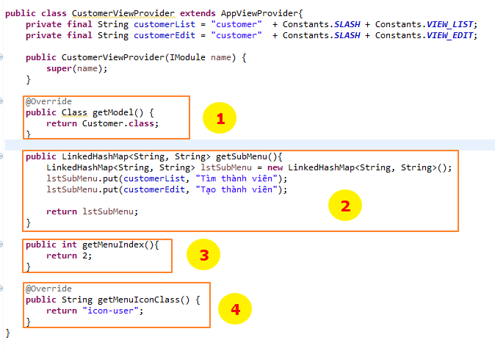
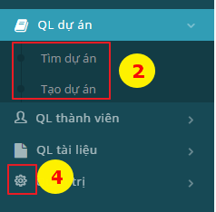
>> Create new module View provider class
Declare your model
Declare sub menu
Order menu
Set menu icon
Author: phuongkim – Date: 14/03/2016

Slide 9
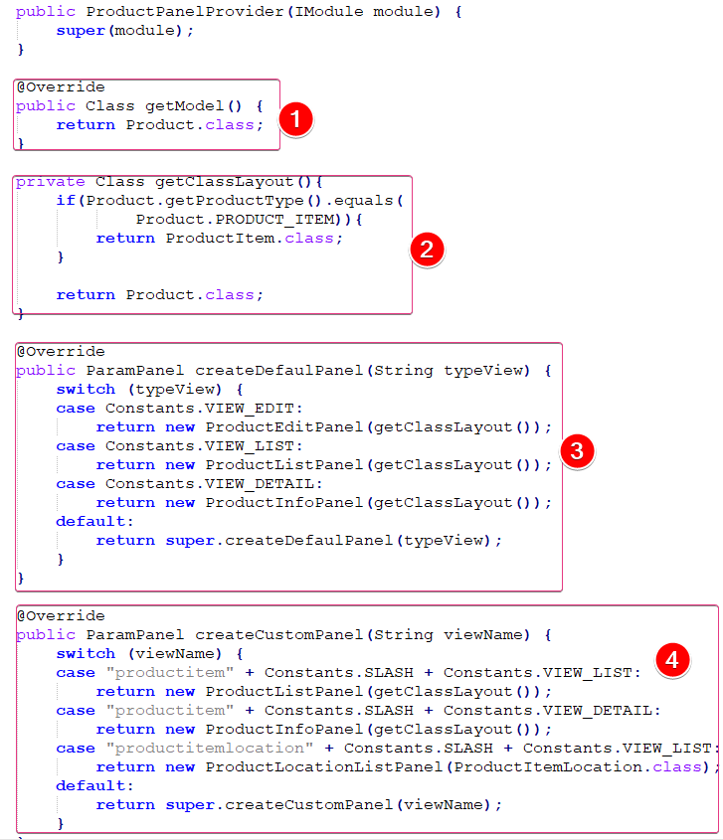
>> Create new module Panel provider class
Declare your model
Declare layout class
Declare default panel
Declare custom panel
Author: phuongkim – Date: 10/06/2019

Slide 10
>>Create new module Model contents
Defind class
List config
Edit config
Related list config
Role and tag
System functions
Import key and change history
Author: phuongkim – Date: 14/03/2016

Slide 11
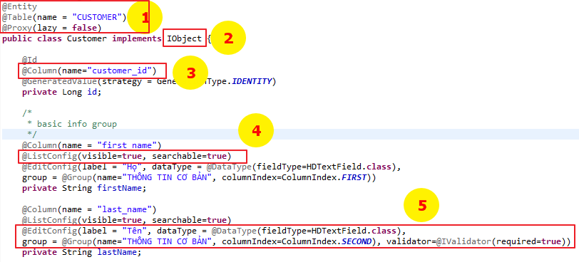
>> Create new module Model class
Declare necessary annotations (database table name)
Must implement from Iobject or IObject2 interface. (for import must implement IImport interface and Iemail for send email)
Declare database column name
Declare items which are showing on search screen
Declare items which are showing on edit and view screen
Author: phuongkim – Date: 10/06/2019

Slide 12
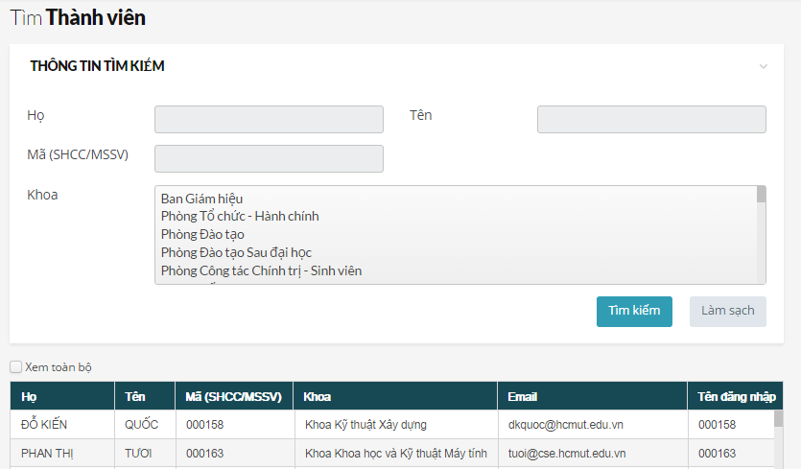
>> Create new module Model class – ListConfig attributes (1)
Author: phuongkim – Date: 14/03/2016

Slide 13
>> Create new module Model class – ListConfig attributes (2)
No. | Attribute (require) | Return type | Value | Description
1 | visible | boolean | True / false | Show column in list view
2 | queue | boolean | boolean | Set column wait for showing on list
3 | name | String | Any text | Display column header
4 | typeFormat | Class<? Extends Converter> | See “Converter component” | Format display value like email, number, date …
5 | defaultSort | String | ASC / DESC | Sort column value by ASC or DESC
6 | searchable | boolean | True / false | Show attribute on search panel
7 | customSearch + fieldType + fieldQuery + defaultSearch + searchOnSet | @CustomSearch + Class + String + boolean + boolean | + See “Search component” + See “Define search query” + True / false | + Search field type + Search on field if there is a join + Default show in search panel + Search on link iobject m2one, m2m
8 | isMassUpdate | Boolean | True / false | Show in mass update panel
9 | columnIndex | int |  | Order column from left to right
10 | columnWidthPercent | int |  | Expand column with given percentage
11 | defaultSearchValue | String | Depend on component | Default search with given value
12 | useForAutocompleteComponent | boolean |  | Using for suggested component
13 | columnIndex | int |  | Order column in list panel
14 | columnWidthPercent | int |  | Set size coumn in list panel
Author: phuongkim – Date: 10/06/2019

Slide 14
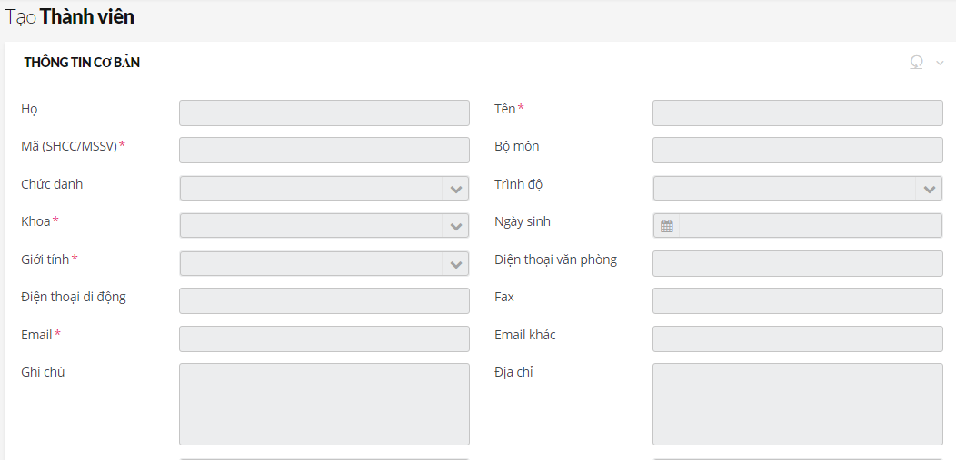
>> Create new module Model class – EditConfig attributes (1)
Author: phuongkim – Date: 14/03/2016

Slide 15
>> Create new module Model class – EditConfig attributes (2)
No. | Attribute (require) | Return type | Value | Description
1 | visible | boolean | True / false | Show column in list view
2 | system | boolean | True / false
3 | group + name + iconClass + groupIndex + viewOneColumnInInfoPanel | @Group + String + String + @ColumnIndex + boolean | + Any value + Class name + First / Second / Merge | Put some fields into group
4 | Lable (*) | String | Any text | Display field label
5 | dataType + fieldType + typeFormat + defaultValue | @Datatype + Class + Class + String | + See “component” + See “Converter component” + Any string | Set field type and set text input format
6 | description | String | Any value
7 | validator + typeValidator + required + minLength + maxLength + startDate + endDate | @Ivalidator + Class + boolean + int + int + String + String | - + extends Validator + True / false + Integer value + Integer value + Date as string value + Date as string value | Set validate for field + Custom validation + Set field require + Set min length + Set max length + Set start date (date field) + Set end date (date field)
8 | readOnly | boolean | True / false | Display in info panel only
9 | hideIfZezo | boolean | True / false | Hide if value = 0
10 | editOnly | boolean | True / false | Display in edit panel only
11 | allowImport | boolean | True / false | Allow showing in import panel
12 | columnIndex | @ColumnIndex | FIRST/SECOND/MERGE
Author: phuongkim – Date: 10/06/2019

Slide 16
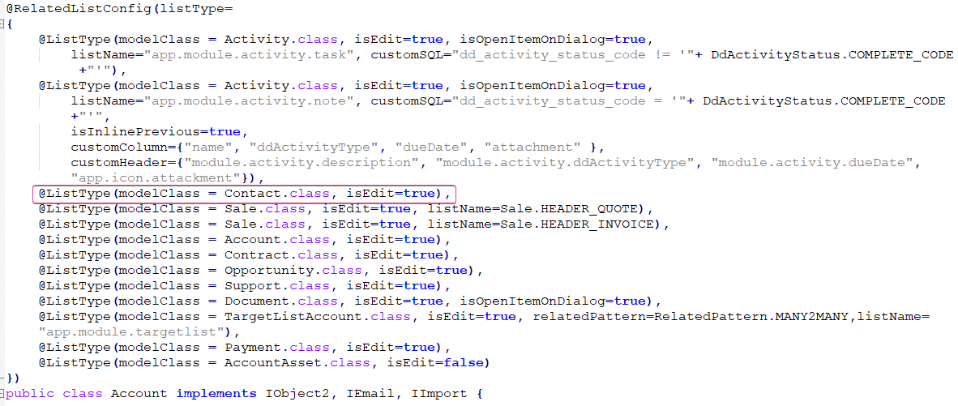
>> Create new module Model class – Related list (1)
Declare all related lists above main object like image above
isEdit: show or not show edit button
listName: define if changing default name
isOpenItemOnDialog: show dialog panel when edit item or jump to view
Author: phuongkim – Date: 14/03/2016

Slide 17
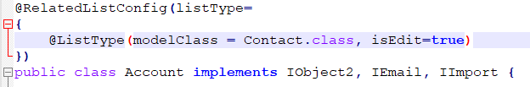
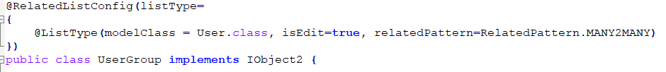

>> Create new module Model class – Related list (2)
- RelatedPattern: RELATE LIST TYPE
PARRENT_CHILD: Related list for many to one relationship
Ex: Account and contact is a m2one relationship (account has many contacts)
MANY2MANY: Related list for many to many relationship
Ex: user and usergroup is a m2m relationship (do not map table many many)
MANY2MANY_VALUE: Related list for many to many relationship has many many table with multiple column
Ex: productitem and location is a m2m relationship has values, so we need map table manymany (ProductItemLocation)
Author: phuongkim – Date: 14/03/2016

Slide 18
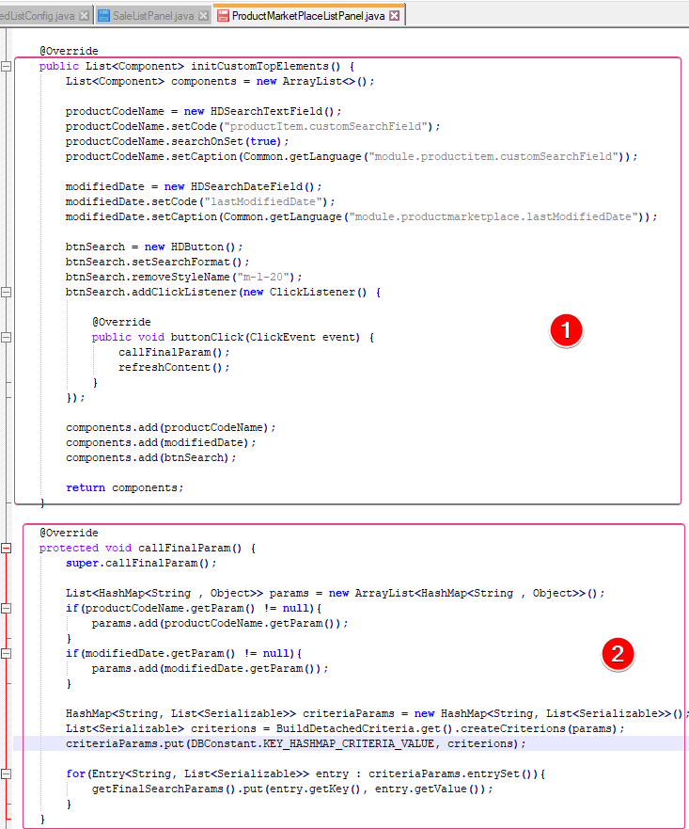
>> Create new module Model class – Related list (3)
Show criteria above related list panel, we need overide list panel for this object.
Example: ProductMarketPlaceListPanel is a related list panel showed on market detail panel
Overide initCustomTopElements funtion for declaring search fields
2. Overide callFinalParam function for adding custom search value to final parameter.
Author: phuongkim – Date: 14/03/2016

Slide 19
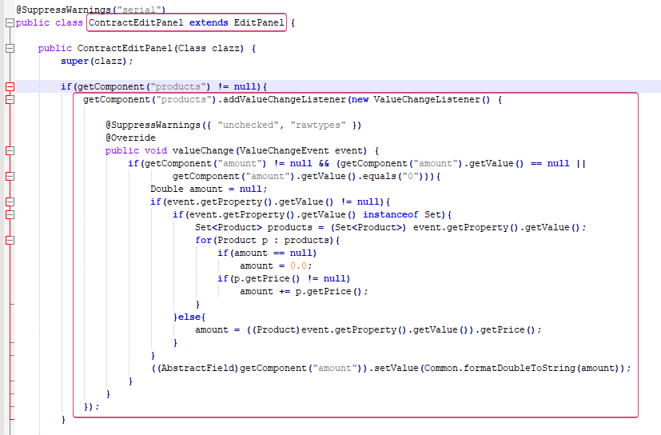
>> Create new module Model class – Custom edit panel
Following step to overide a panel
Step 1: Create a class in module which object is registered
Step 2: Class is extended EditPanel
Step 3: Register new customer panel in panel provider in this module
Ex: overide contract edit panel to catch changing product field value then get price to set amount field
Author: phuongkim – Date: 14/03/2016

Slide 20
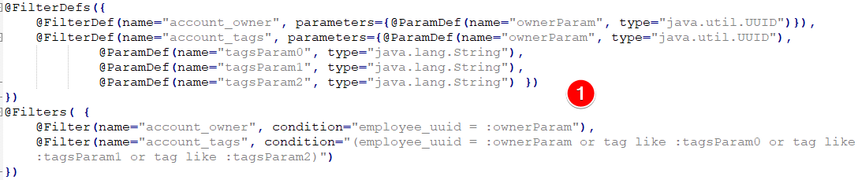
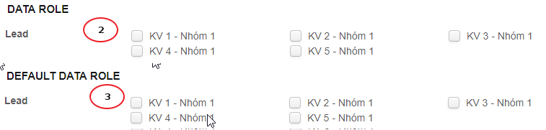
>> Create new module Model class – Role and tag
Role is function to access panel
Role active: show menu
Role search: access search panel
Role view: access info panel
Role edit: access create/edit panel
Role delete: can delete object
Role export: can export object
Role import: access import panel
Tag is using for access data
Declare in object above class (public class Lead)
Set access tag
Set default access tag
Author: phuongkim – Date: 14/03/2016

Slide 21
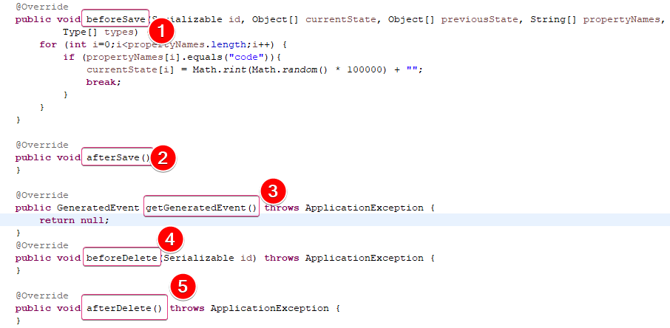
>> Create new module Model class – Systems function
Before save: re-set attribute value before commit into database
After save: do job after commit object into database
GetGeneratedEvent: Create custom event
Before delete: do job before delete object
After delete: do job after delete object
Author: phuongkim – Date: 14/03/2016

Slide 22
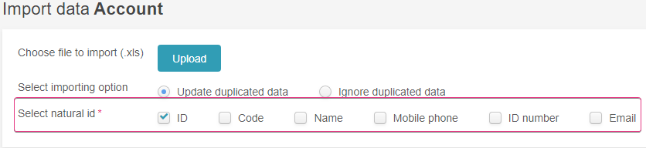
>> Create new module Model class – Import key and history
Declare key for import object
Declare change history
Author: phuongkim – Date: 14/03/2016

Slide 23
Development guide HD New FW
Import module into project
Author: phuongkim – Date: 14/03/2016

Slide 24
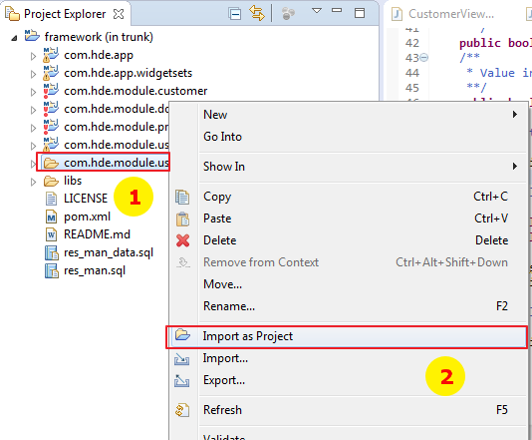
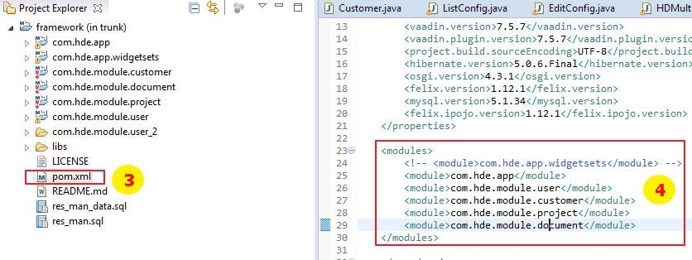
>> Import module into project (eclipse)
Right click on module
Choose “Import as Project”
Open pom.xml of framework
Register new module
Author: phuongkim – Date: 14/03/2016

Slide 25
Development guide HD New FW
Build and run
Author: phuongkim – Date: 14/03/2016

Slide 26
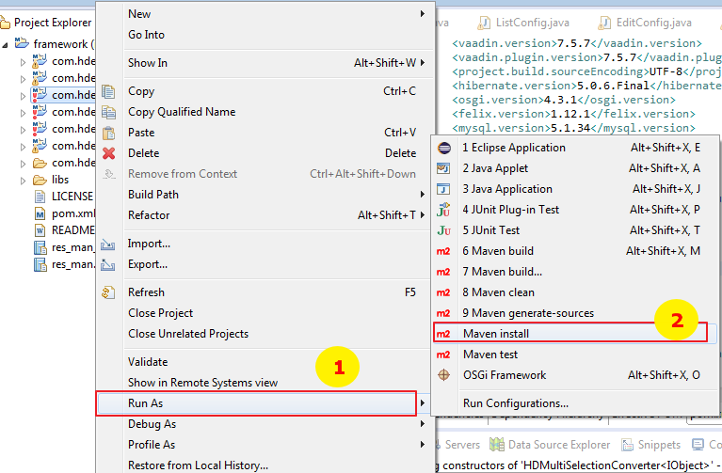
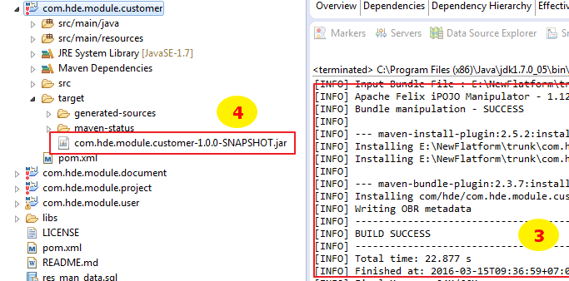
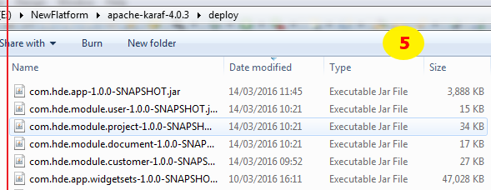
>> Build and run
Right click on module -> run as
Choose “Maven install”
Wait until build success
Copy jar file from target of module
Past to deploy folder of apache-karaf. Finally, you can run it on browser with url: http://localhost:8181/bk-resman
Author: phuongkim – Date: 14/03/2016

Slide 27
Development guide HD New FW
Appendices
Author: phuongkim – Date: 14/03/2016

Slide 28
>> Appendices Components (1)
No. | Name | Search component | Description
1 | HDTextField | HDSearchTextField
2 | HDTextArea | HDSearchTextField
3 | HDPhoneField | HDSearchPhoneField
4 | HDPassword | -
5 | HDNumberField | HDSearchNumberField and HDSearchNumberRange
6 | HDIntegerNumberField | HDSearchIntegerField and HDSearchIntegerRange
7 | HDEmailField | HDSearchTextField
8 | HDDateField | HDSearchDateRange and HDSearchDateField
9 | HDCurrencyField | HDSearchNumberField and HDSearchNumberRange
10 | HDItemCodeListSelect | HDSearchItemCodeListSelect
11 | HDItemCodeGroupRadio | HDSearchGroupRatio
12 | HDItemCodeGroupCheckbox | HDSearchItemCodeListSelect
13 | HDItemCodeCombobox | HDSearchItemCodeComboBox
14 | HDFileUploader | -
15 | HDCheckBox | HDSearchBooleanField
16 | HDCombobox | -
17 | HDDateTimeField | HDSearchDateRange
18 | HDIObjectCombobox | HDSearchIObjectListSelect
19 | HDItemCodeGroupRadio | HDSearchItemCodeListSelect
Author: phuongkim – Date: 10/06/2019

Slide 29
>> Appendices Components (2)
No. | Name | Search component | Description
20 | HDSingleSelectionItemBox | Using for custom search (for iobject has many to one relationship)
21 | HDMultiSelectionItemBox | Using for iobject has many to many relationship
22 | HDComplexSelection | Using for bach khoa project
23 | HDRoleGroupCheckbox | -
24 | HDYearCombobox | HDSearchYearCombobox
25 | HDUniqueTextField | HDSearchTextField
26 | HDTimeCombobox | -
27 | HDSuggestionField | HDSearchTextField
28 | HDSuggestionCombobox | Using for product in sale lines
29 | HDSingleSelectionCreateItemBox | for iobject has many to one relationship
30 | HDSingleRelatedComponent | For find duplicated
31 | HDPercentageField | -
32 | HDMonthCombobox | HDSearchMonthField
33 | HDListEditor (HDListCreateObject - depreciated) | This component is used for sale lines, purchase lines …
34 | HDLabelField | Using in edit config for displaying label only (form object)
35 | HDWebsiteField
36 | HDRichTextArea | - | For email template
37 | HDMultiFileUploaderField | - | For upload multiple files
Application is automatic convert edit component to search component. But we can use custom search component (place in fieldType of custom search annotation)
Author: phuongkim – Date: 10/06/2019

Slide 30
>> Appendices Converter components (1)
No. | Name | Description
1 | HDDateToStringConverter
2 | HDIDToIObjectConverter
3 | HDItemCodeConverter
4 | HDMultiIObjectConverter
5 | HDMultiItemCodeConverter
6 | HDStringToDateConverter
7 | HDMultiSelectionConverter
8 | HDIObjectConverter | Using for writing components
9 | HDListIObjectConverter | Using for writing components
10 | HDStringToBooleanConverter
When we use converter component
+ Display custom format
+ Display other (not default) column of link table
Define new converter class, must extends from converter class
Author: phuongkim – Date: 14/03/2016

Slide 31
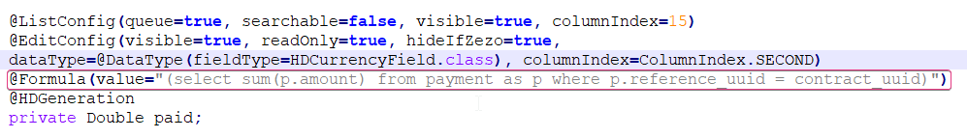
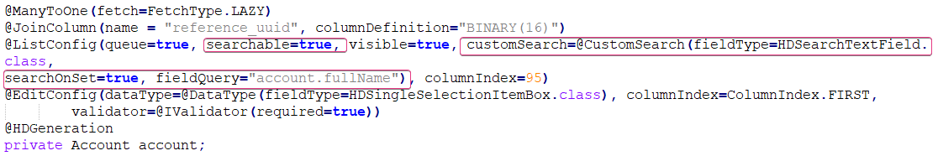
>> Appendices Define formula and search query
Search query will be defined when there is a join with other table except item code table.
Example:
Formula for get paid amount in contract
Search account in contract: fieldQuey = “account.fullName” account is attribute in contract and fullName is attribute in account
Author: phuongkim – Date: 14/03/2016

Slide 32
Development guide HD New FW
Service
Author: phuongkim – Date: 14/03/2016

Slide 33
>>Service Contents
Create service module
Generation doc (free marker)
Rule service
Bis service
Author: phuongkim – Date: 14/03/2016

Slide 34
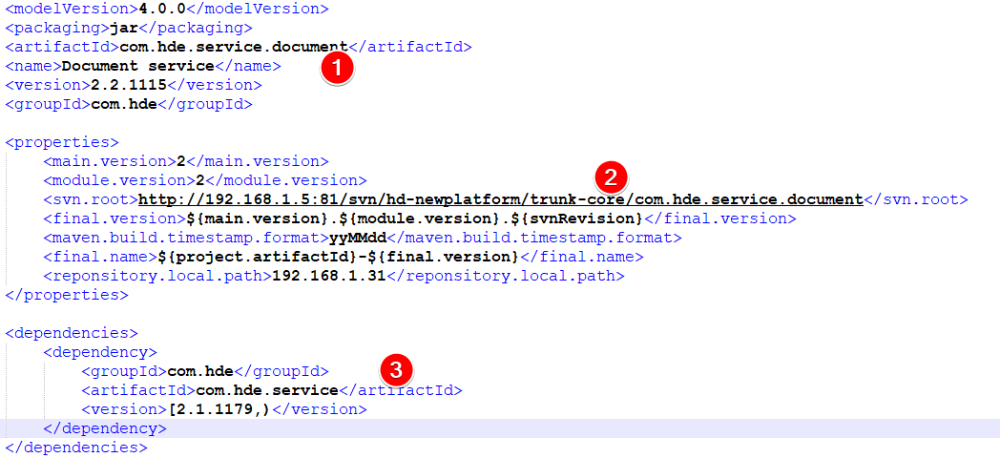
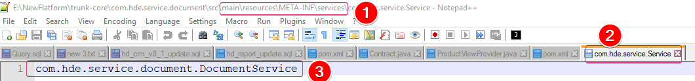
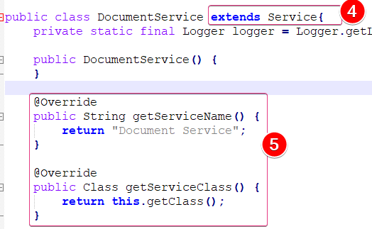
>> Service Create service module (1)
pom file
Module name
Svn link
dependencies
create service file
Place in folder
“main/resources/META-INF/service”
File name “com.hde.service.Service”
Service package
Class must extends service class
Defind service name
Author: phuongkim – Date: 10/06/2019

Slide 35
>> Service Create service module (2)
build to jar file and place in best-service/bin/service folder
Config to turn off some services in app service by list all services want to turn off in service-app.properties
app.service.off=BISService;ImportFileService;RuleService;XMLService;EmailService;CalendarService
Author: phuongkim – Date: 10/06/2019

Slide 36
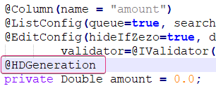
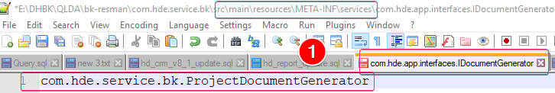
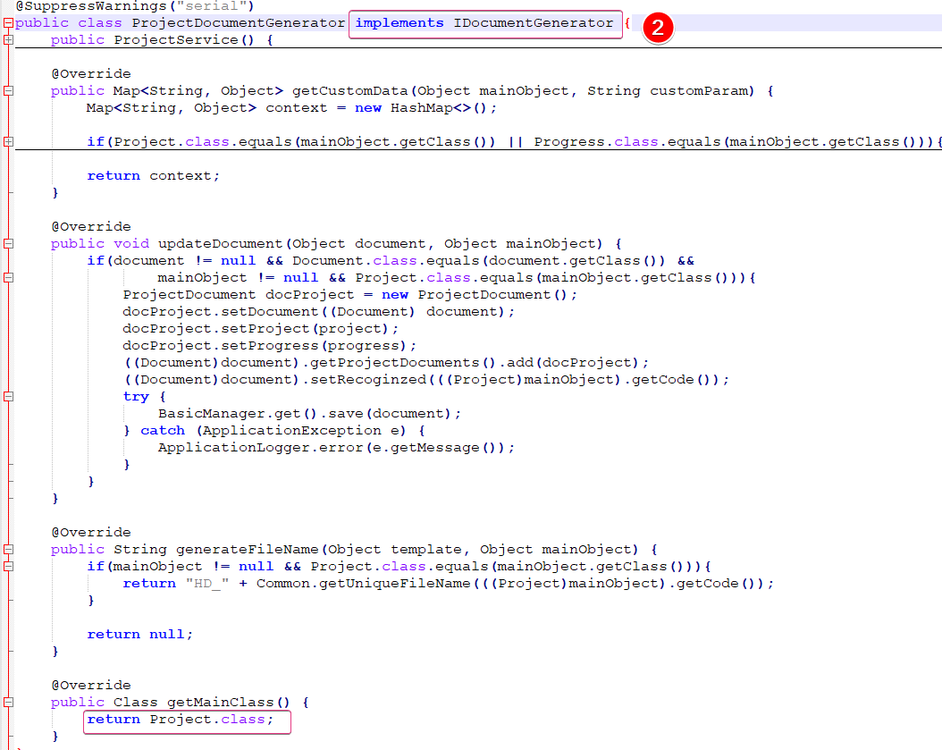
>> Service Generation doc (free marker) (1)
Config attribute in iobject
with anotation @HDGeneration
Defind custom generation (if it is necessary)
Register custom by place in
“scr/main.resources/META-INF/Services” file
“com.hde.app.interface.IDocumentGenerator”
With content is the package
Of file
File must implements IDocumentGenerator
and main class must the same main object one
to generation docment
Author: phuongkim – Date: 10/06/2019

Slide 37
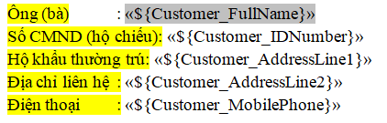
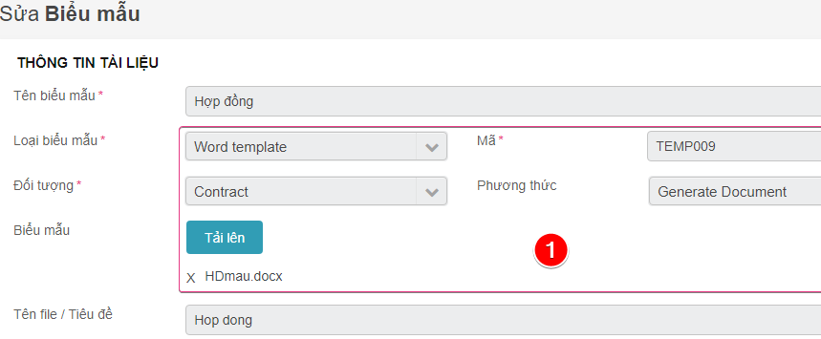
>> Service Generation doc (free marker) (2)
Create doc file:
After run service, a text file will be created in appdata\mysql_databasename\temporary\generated
Import text file into word by select “Maillings -> select recipients -> use existing list”
Add field to word file like mail merge
Config in frameword
Create template with word template
and Generate document method
Add role generate for main object
Generate button will display in info panel
Author: phuongkim – Date: 10/06/2019

Slide 38
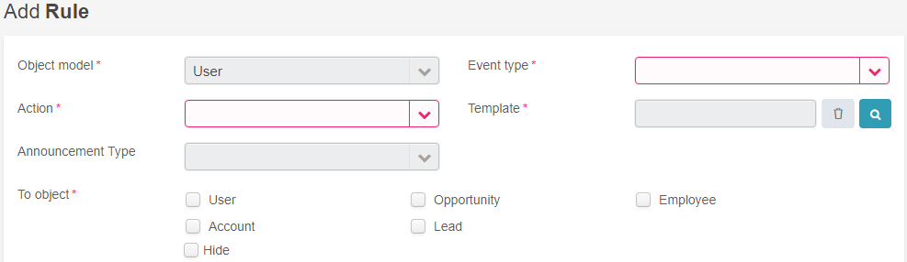
>> Service Rule service
Create new rule for iobject
App will auto create event create, update, delete if the object has a rule depend on.
If you want to create custom rule -> custom event must be created in function getGeneratedEvent of IObject
Author: phuongkim – Date: 10/06/2019

Slide 39
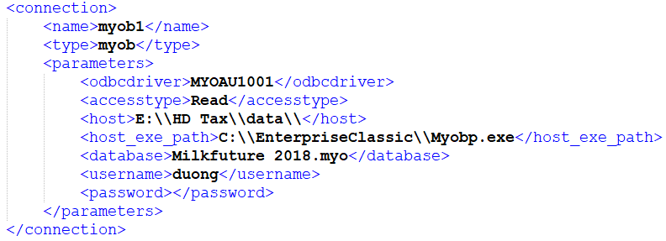
>> Service Bis service
Create xml file with select or update queries then place in best-service/queries or you can place in sub folder in queries folder
Config service-app.properties.
if xml file place in queries folder -> set app.bis.queries.subfolder=
if xml file place in sub folder -> set app.bis.queries.subfolder=subfolder
Config ConnectionString.xml
Check syn myob role if you do not see ”m” icon in top bar
Author: phuongkim – Date: 10/06/2019

